Slide 1
Project Proposal
Tiffany W & Evelyn Jane

Slide 2
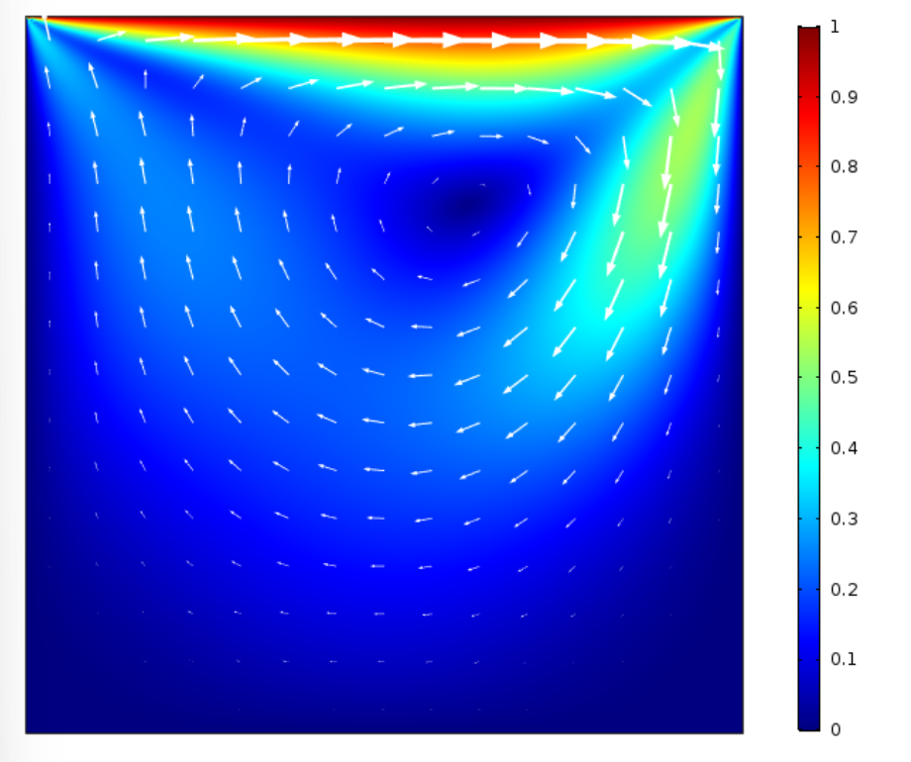
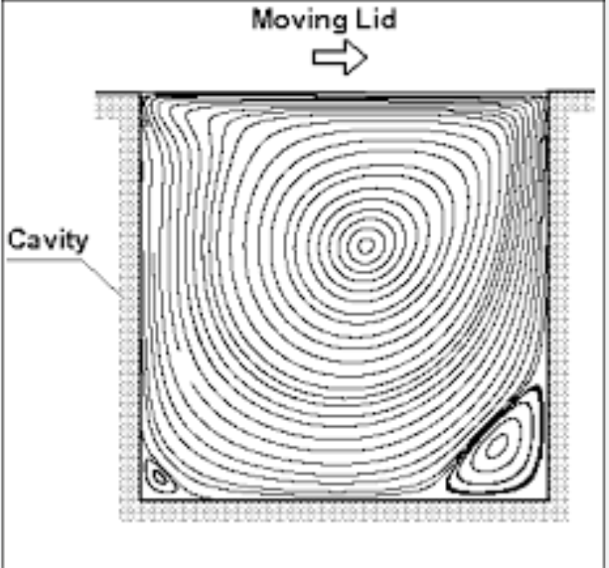
Chosen topic
Fluid Dynamics:
Simulating fluid flow around an object using Navier-Stokes equations.
Simulation of Lid-Driven Cavity Flow with Internal Obstacles using Chorin’s Projection Method.

Slide 3
Physical Process Description
The Scenario: A 2D square "cavity" filled with an incompressible fluid (like water).
The Driver: The top boundary moves at a constant velocity, dragging the fluid and creating a primary vortex.
The Complexity: We are introducing a solid internal obstacle to study how it disrupts the flow and changes the pressure distribution.
Application: This models real-world scenarios like coolant moving around components in an engine.

Slide 4

Mathematical Background
Governing Equations: The motion is governed by the Incompressible Navier-Stokes Equations.
Conservation of Momentum:
$\frac{\text{∂}\text{u}}{\text{∂}\text{t}}+\left(u∙∇\right)u=−\frac{1}{ρ}∇p+ν∇^{2}u$
$\frac{\text{∂}\text{u}}{\text{∂}\text{t}}$ How the fluid speed at a specific point changes over time.
$\left(u∙∇\right)u$ Acceleration caused by the fluid moving from one position to another with a different velocity.
$−\frac{1}{ρ}∇p$ Pressure gradient.
$ν∇^{2}u$ Diffusion (Viscosity).
Conservation of Mass (Continuity):
$∇∙u=0$
For an incompressible fluid (like water), the amount of fluid entering a space must equal the amount leaving it.

Slide 5
Computational & Numerical Techniques
Technique: Chorin’s Projection Method, a splitting scheme that separates velocity and pressure calculations.
Discretization: We use Finite Difference Methods on a structured grid (Mesh) to approximate derivatives.
Boundary Conditions:
No-Slip: Velocity is zero at all solid walls and the internal obstacle.
Driven Lid: Velocity is constant at the top boundary.

Slide 6
Expected Outcomes & Error Analysis
We expect to see a large primary vortex
Obstacle Impact: We will analyze how the size and position of the box affect the drag and flow pattern.
Error Analysis: We will perform a stability check using the CFL condition to ensure our time-step (∆t) is small enough to prevent the simulation from "exploding".
Sidenote: if we change from Chorin’s Projection Method and use Stream Function Vorticity instead, we don’t need to use ∆t

